Slide 1
Sum, prod, mean of rows
author kreodebunk
many thanks to Nephilim

Slide 2
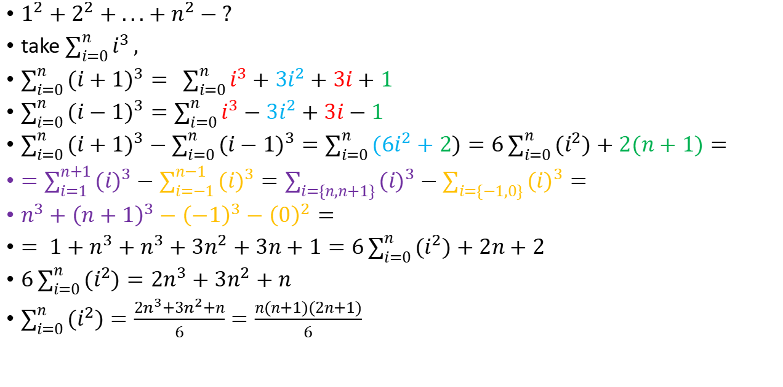
Summ of squares:
$1^{2}+2^{2}+...+n^{2}−?$
take $\sum_{i=0}^{n}{i^{3}},$
$\sum_{i=0}^{n}{{(i+1)}^{3}}= \sum_{i=0}^{n}{i^{3}+{3i}^{2}+3i+1}$
$\sum_{i=0}^{n}{{(i−1)}^{3}}=\sum_{i=0}^{n}{i^{3}−{3i}^{2}+3i−1}$
$\sum_{i=0}^{n}{{(i+1)}^{3}}−\sum_{i=0}^{n}{{(i−1)}^{3}}=\sum_{i=0}^{n}{{(6i}^{2}+2)}=6\sum_{i=0}^{n}{{(i}^{2})+2(n+1)}=$
$=\sum_{i=1}^{n+1}{{(i)}^{3}}−\sum_{i=−1}^{n−1}{{(i)}^{3}}=\sum_{i=\{n,n+1\}}{{(i)}^{3}}−\sum_{i=\{−1,0\}}{{(i)}^{3}}=$
$n^{3}+{\left(n+1\right)}^{3}−{\left(−1\right)}^{3}−{\left(0\right)}^{2}=$
$= 1+n^{3}+n^{3}+3n^{2}+3n+1=6\sum_{i=0}^{n}{{(i}^{2})+2n}+2$
$6\sum_{i=0}^{n}{{(i}^{2})}=2n^{3}+3n^{2}+n$
$\sum_{i=0}^{n}{{(i}^{2})}=\frac{2n^{3}+3n^{2}+n}{6}=\frac{n(n+1)(2n+1)}{6}$

Slide 3
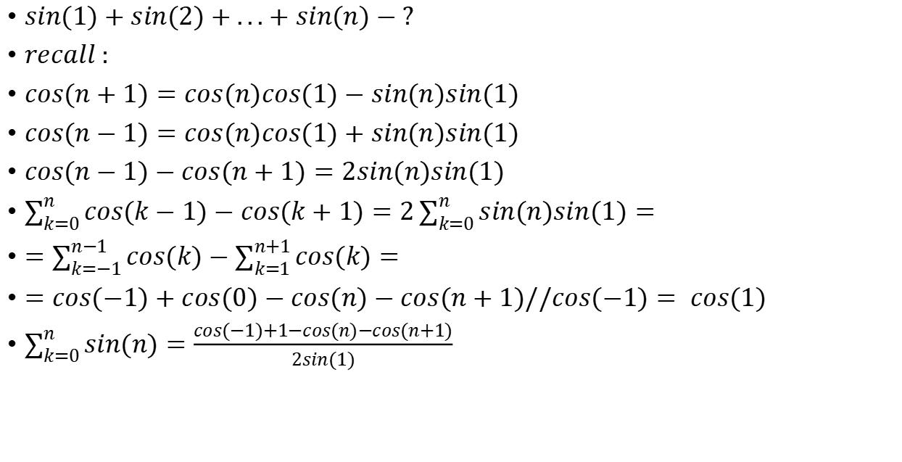
Sum of sines:
$sin(1)+sin(2)+...+sin(n)−?$
$recall :$
$cos(n+1)=cos(n)cos(1)−sin(n)sin(1)$
$cos(n−1)=cos(n)cos(1)+sin(n)sin(1)$
$cos(n−1)−cos(n+1)=2sin(n)sin(1)$
$\sum_{k=0}^{n}{cos(k−1)−cos(k+1)}=2\sum_{k=0}^{n}{sin(n)sin(1)}=$
$=\sum_{k=−1}^{n−1}{cos(k)}−\sum_{k=1}^{n+1}{cos(k)}=$
$=cos(−1)+cos(0)−cos(n)−cos(n+1)//cos(−1)= cos(1)$
$\sum_{k=0}^{n}{sin(n)}=\frac{cos(−1)+1−cos(n)−cos(n+1)}{2sin(1)}$

Slide 4
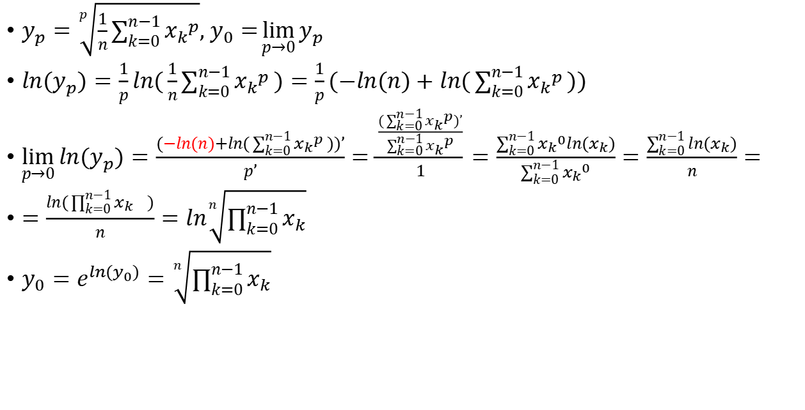
Geom mean as a limit of power mean(Nephilim):
$y_{p}=\sqrt[p]{\frac{1}{n}\sum_{k=0}^{n−1}{{x_{k}}^{p}}}, y_{0}=\lim_{p→0}{y_{p}}$
$ln{(y}_{p})=\frac{1}{p}ln(\frac{1}{n}\sum_{k=0}^{n−1}{{x_{k}}^{p}})=\frac{1}{p}(−ln(n)+ln(\sum_{k=0}^{n−1}{{x_{k}}^{p}}))$
$\lim_{p→0}{{ln(y}_{p})=\frac{(−ln(n)+ln(\sum_{k=0}^{n−1}{{x_{k}}^{p}}))’}{p’}}=\frac{\frac{(\sum_{k=0}^{n−1}{{x_{k}}^{p})’}}{\sum_{k=0}^{n−1}{{x_{k}}^{p}}}}{1}=\frac{\sum_{k=0}^{n−1}{{x_{k}}^{0}ln{(x}_{k})}}{\sum_{k=0}^{n−1}{{x_{k}}^{0}}}=\frac{\sum_{k=0}^{n−1}{ln{(x}_{k})}}{n}=$
$=\frac{ln{(\prod_{k=0}^{n−1}{x_{k}}}_{})}{n}=ln\sqrt[n]{\prod_{k=0}^{n−1}{x_{k}}}$
$y_{0}=e^{{ln(y}_{0})}=\sqrt[n]{\prod_{k=0}^{n−1}{x_{k}}}$

Slide 5

Limit of power mean 2:
Task 2 - find ${(y}_{∞})$
$\lim_{p→∞}{{ln(y}_{p})=\frac{(−ln(n)+ln(\sum_{k=0}^{n−1}{{x_{k}}^{p}}))’}{p’}}=\frac{\sum_{k=0}^{n−1}{{x_{k}}^{p}ln{(x}_{k})}}{\sum_{k=0}^{n−1}{{x_{k}}^{p}}}$
for each $x_{k}=c$:
$\lim_{p→∞}\frac{c^{p}}{\sum_{k=0}^{n−1}{{x_{k}}^{p}}}=\lim_{p→∞}\frac{1}{\sum_{k=0}^{n−1}{{\left(\frac{x_{k}}{c}\right)}^{p}}}=$

Slide 6
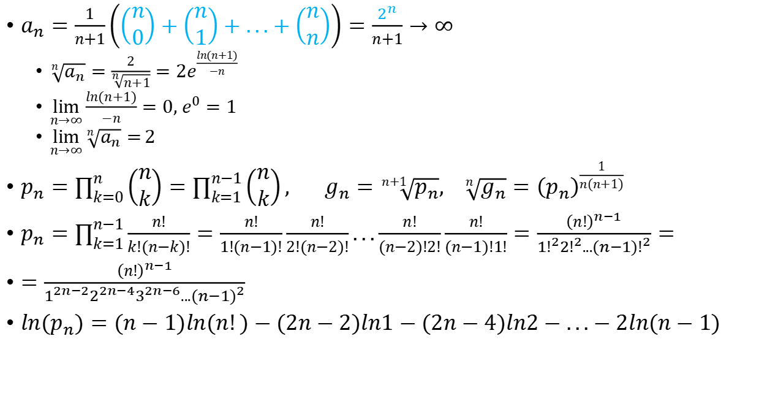
On means of binomial coefficients (Michael Penn,youtube
$a_{n}=\frac{1}{n+1}\left(\left(\begin{matrix}n \\ 0\end{matrix}\right)+\left(\begin{matrix}n \\ 1\end{matrix}\right)+...+\left(\begin{matrix}n \\ n\end{matrix}\right)\right)=\frac{2^{n}}{n+1}→∞$
$\sqrt[n]{a_{n}}=\frac{2}{\sqrt[n]{n+1}}=2e^{\frac{ln(n+1)}{−n}}$
$\lim_{n→∞}{\frac{ln(n+1)}{−n}}=0, e^{0}=1$
$\lim_{n→∞}{\sqrt[n]{a_{n}}=}2$
$p_{n}=\prod_{k=0}^{n}{\left(\begin{matrix}n \\ k\end{matrix}\right)}=\prod_{k=1}^{n−1}{\left(\begin{matrix}n \\ k\end{matrix}\right)}, g_{n}=\sqrt[n+1]{p_{n}}, \sqrt[n]{g_{n}}={\left(p_{n}\right)}^{\frac{1}{n(n+1)}}$
$p_{n}=\prod_{k=1}^{n−1}{\frac{n!}{k!(n−k)!}}=\frac{n!}{1!(n−1)!}\frac{n!}{2!(n−2)!}...\frac{n!}{(n−2)!2!}\frac{n!}{(n−1)!1!}=\frac{{\left(n!\right)}^{n−1}}{{1!}^{2}{2!}^{2}...{(n−1)!}^{2}}=$
$=\frac{{\left(n!\right)}^{n−1}}{1^{2n−2}2^{2n−4}3^{2n−6}...{(n−1)}^{2}}$
$ln(p_{n})=(n−1)ln(n!)−(2n−2)ln1−(2n−4)ln2−...−2ln(n−1)$

Slide 7
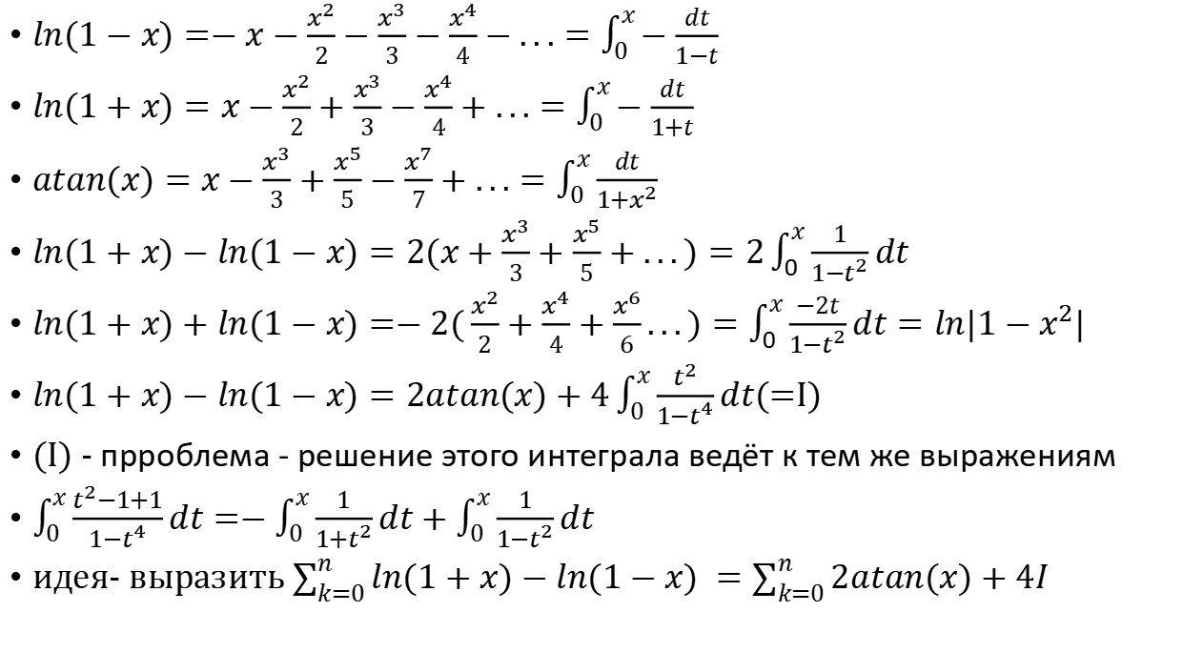
Sum of ln or arctan - background:
$ln(1−x)=−x−\frac{x^{2}}{2}−\frac{x^{3}}{3}−\frac{x^{4}}{4}−...=\int_{0}^{x}{−\frac{dt}{1−t}}$
$ln(1+x)=x−\frac{x^{2}}{2}+\frac{x^{3}}{3}−\frac{x^{4}}{4}+...=\int_{0}^{x}{−\frac{dt}{1+t}}$
$atan(x)=x−\frac{x^{3}}{3}+\frac{x^{5}}{5}−\frac{x^{7}}{7}+...=\int_{0}^{x}{\frac{dt}{1+x^{2}}}$
$ln(1+x)−ln(1−x)=2(x+\frac{x^{3}}{3}+\frac{x^{5}}{5}+...)=2\int_{0}^{x}{\frac{1}{1−t^{2}}dt}$
$ln(1+x)+ln(1−x)=−2(\frac{x^{2}}{2}+\frac{x^{4}}{4}+\frac{x^{6}}{6}...)=\int_{0}^{x}{\frac{−2t}{1−t^{2}}dt}=ln|1−x^{2}|$
$ln(1+x)−ln(1−x)=2atan(x)+4\int_{0}^{x}{\frac{t^{2}}{1−t^{4}}}dt$(=I)
(I) - прроблема - решение этого интеграла ведёт к тем же выражениям
$\int_{0}^{x}{\frac{t^{2}−1+1}{1−t^{4}}}dt=−\int_{0}^{x}{\frac{1}{1+t^{2}}}dt+\int_{0}^{x}{\frac{1}{1−t^{2}}}dt$
идея- выразить $\sum_{k=0}^{n}{ln(1+x)−ln(1−x) }=\sum_{k=0}^{n}{2atan(x)+4I }$

Slide 8
Sum of ln or arctan- try:

Slide 9
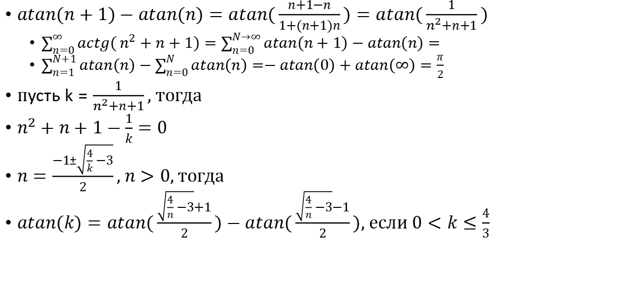
Сумма ряда с арккотангенсом из олимпиады (Putnam) , Hmath, youtube
$atan(n+1)−atan(n)=atan(\frac{n+1−n}{1+(n+1)n})=atan(\frac{1}{n^{2}+n+1})$
$\sum_{n=0}^{∞}{actg(}n^{2}+n+1)=\sum_{n=0}^{N→∞}{atan(n+1)−atan(n)}=$
$\sum_{n=1}^{N+1}{atan(n)}−\sum_{n=0}^{N}{atan(n)}=−atan(0)+atan(∞)=\frac{π}{2}$
$пусть k=\frac{1}{n^{2}+n+1}, тогда$
$n^{2}+n+1−\frac{1}{k}=0$
$n=\frac{−1±\sqrt{\frac{4}{k}−3}}{2}, n>0,тогда$
$atan(k)=atan(\frac{\sqrt{\frac{4}{n}−3}+1}{2})−atan(\frac{\sqrt{\frac{4}{n}−3}−1}{2}), если 0<k≤\frac{4}{3}$

Slide 10

Sum of atans:
$atan(1)+atan(2)+...+atan(n)$
Using integral:$atan(x)=\int_{0}^{x}{\frac{1}{1+x^{2}}}dx$
$\sum_{k=0}^{n}{atan(k)}=\int_{0}^{x}{\sum_{k=0}^{n}{\frac{1}{1+k^{2}}}}dx$
$\sum_{k=0}^{n}{\frac{1}{1+k^{2}}}$=-?

Slide 11
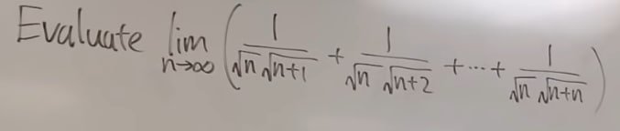
main=$\frac{1}{n}(\sqrt{\frac{n}{n+1}}+\sqrt{\frac{n}{n+2}}+...+\sqrt{\frac{n}{n+n}})=\frac{1}{n}(\sqrt{\frac{1}{1+\frac{1}{n}}}+\sqrt{\frac{1}{1+\frac{2}{n}}}+...+\sqrt{\frac{1}{1+\frac{n}{n}}})=\sum_{k=1}^{n}{\frac{1}{n}\sqrt{\frac{1}{1+\frac{k}{n}}}}=\int_{x=0}^{1}{\sqrt{\frac{1}{1+x}}dx}=2\sqrt{1+x}|_{0}^{1}=2\sqrt{2}−2$

Slide 12

$\frac{1}{\sqrt{1}+\sqrt{2}}+\frac{1}{\sqrt{2}+\sqrt{3}}+...+\frac{1}{\sqrt{99}+\sqrt{100}}−main$
$\frac{1}{\sqrt{n}+\sqrt{n+1}}=\frac{\sqrt{n+1}−\sqrt{n}}{n+1−n}=\sqrt{n+1}−\sqrt{n}$
$main=\sqrt{2}−\sqrt{1}+\sqrt{3}−\sqrt{2}+...+\sqrt{99}−\sqrt{98}+\sqrt{100}−\sqrt{99}=\sqrt{100}−\sqrt{1}=10−1=9$

Slide 13

$\frac{1}{\sqrt{1}+\sqrt{100}}+\frac{1}{\sqrt{2}+\sqrt{99}}+...+\frac{1}{\sqrt{100}+\sqrt{1}}$
${\left(\frac{1}{\sqrt{2}+\sqrt{99}}\right)}^{2}=\frac{1}{101+2\sqrt{2}\sqrt{99}}$

Slide 14
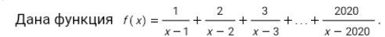

Slide 15
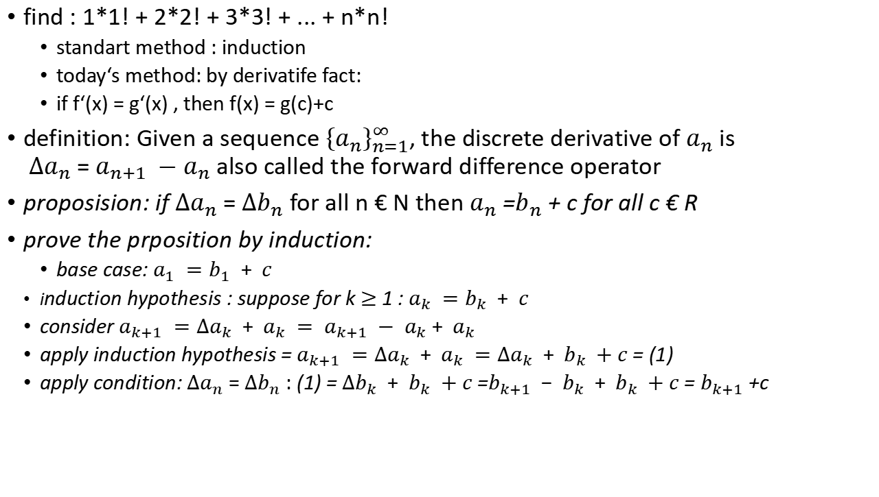
Factorial row
find : 1*1! + 2*2! + 3*3! + ... + n*n!
standart method : induction
today‘s method: by derivatife fact:
if f‘(x) = g‘(x) , then f(x) = g(c)+c
definition: Given a sequence ${\left\{a_{n}\right\}}_{n=1}^{∞}$, the discrete derivative of $a_{n}$ is $∆a_{n}$ = $a_{n+1} −a_{n}$ also called the forward difference operator
proposision: if $∆a_{n}$ = $∆b_{n}$ for all n € N then $a_{n}$ =$b_{n}$ + c for all c € R
prove the prposition by induction:
base case: $a_{1} =b_{1} + c$
induction hypothesis : suppose for k $≥$ 1 : $a_{k} =b_{k} + c$
consider $a_{k+1} ={∆a}_{k} + a_{k} = a_{k+1} − a_{k}+ a_{k}$
apply induction hypothesis = $a_{k+1} ={∆a}_{k} + a_{k} ={∆a}_{k} + b_{k} +c$ = (1)
apply condition: $∆a_{n}$ = $∆b_{n}$ : (1) = ${∆b}_{k} + b_{k} +c$ =$b_{k+1} − b_{k} + b_{k} +c$ = $b_{k+1}$+c

Slide 16
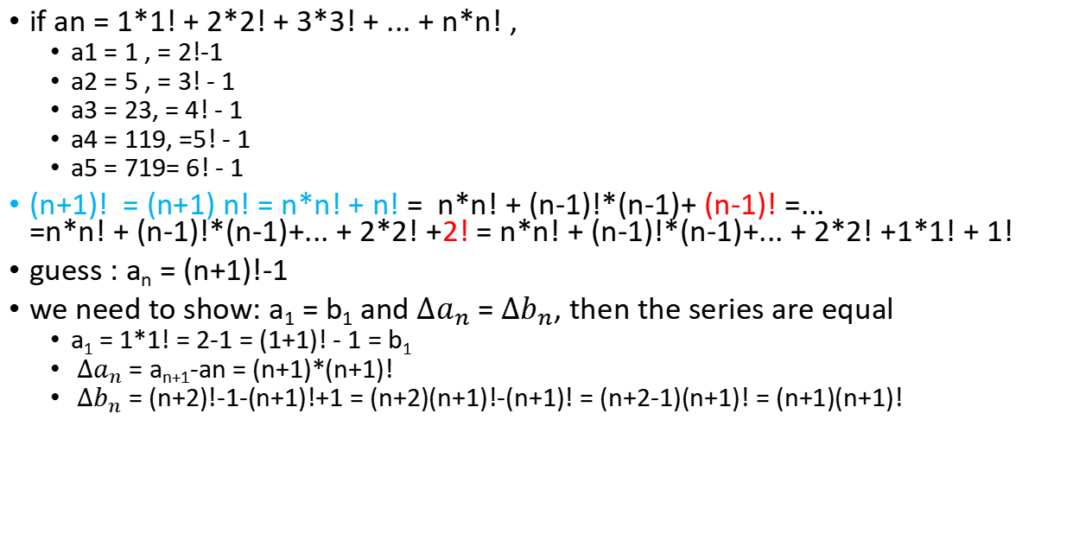
if an = 1*1! + 2*2! + 3*3! + ... + n*n! ,
a1 = 1 , = 2!-1
a2 = 5 , = 3! - 1
a3 = 23, = 4! - 1
a4 = 119, =5! - 1
a5 = 719= 6! - 1
(n+1)! = (n+1) n! = n*n! + n! = n*n! + (n-1)!*(n-1)+ (n-1)! =... =n*n! + (n-1)!*(n-1)+... + 2*2! +2! = n*n! + (n-1)!*(n-1)+... + 2*2! +1*1! + 1!
guess : a_{n} = (n+1)!-1
we need to show: a₁ = b₁ and $∆a_{n}$ = $∆b_{n}$, then the series are equal
a₁ = 1*1! = 2-1 = (1+1)! - 1 = b₁
$∆a_{n}$ = a_{n+1}-an = (n+1)*(n+1)!
$∆b_{n}$ = (n+2)!-1-(n+1)!+1 = (n+2)(n+1)!-(n+1)! = (n+2-1)(n+1)! = (n+1)(n+1)!

Slide 17
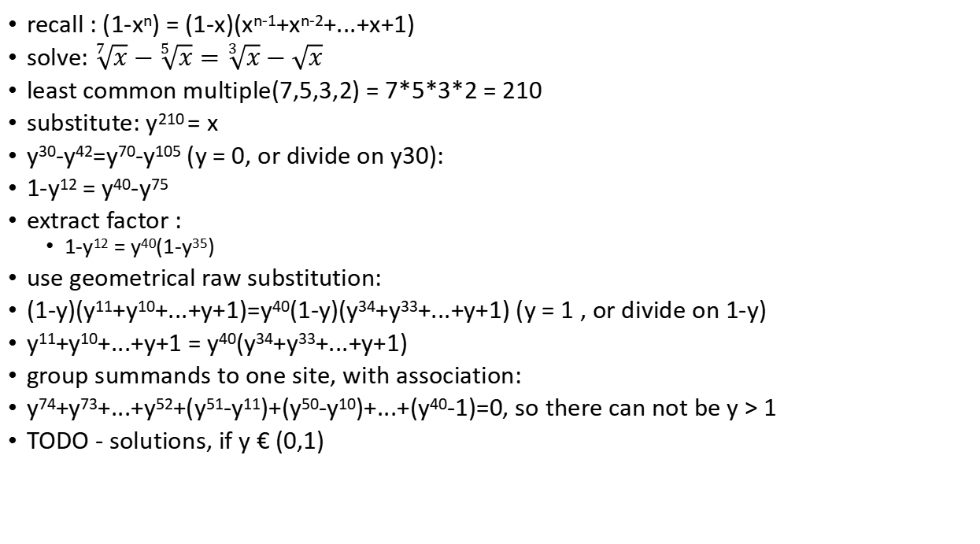
geometrical raw usage
recall : (1-x^{n}) = (1-x)(x^{n-1}+x^{n-2}+...+x+1)
solve: $\sqrt[7]{x}−\sqrt[5]{x}=\sqrt[3]{x}−\sqrt{x}$
least common multiple(7,5,3,2) = 7*5*3*2 = 210
substitute: y²¹⁰ = x
y³⁰-y⁴²=y⁷⁰-y¹⁰⁵ (y = 0, or divide on y30):
1-y¹² = y⁴⁰-y⁷⁵
extract factor :
1-y¹² = y⁴⁰(1-y³⁵)
use geometrical raw substitution:
(1-y)(y¹¹+y¹⁰+...+y+1)=y⁴⁰(1-y)(y³⁴+y³³+...+y+1) (y = 1 , or divide on 1-y)
y¹¹+y¹⁰+...+y+1 = y⁴⁰(y³⁴+y³³+...+y+1)
group summands to one site, with association:
y⁷⁴+y⁷³+...+y⁵²+(y⁵¹-y¹¹)+(y⁵⁰-y¹⁰)+...+(y⁴⁰-1)=0, so there can not be y > 1
TODO - solutions, if y € (0,1)

Slide 18
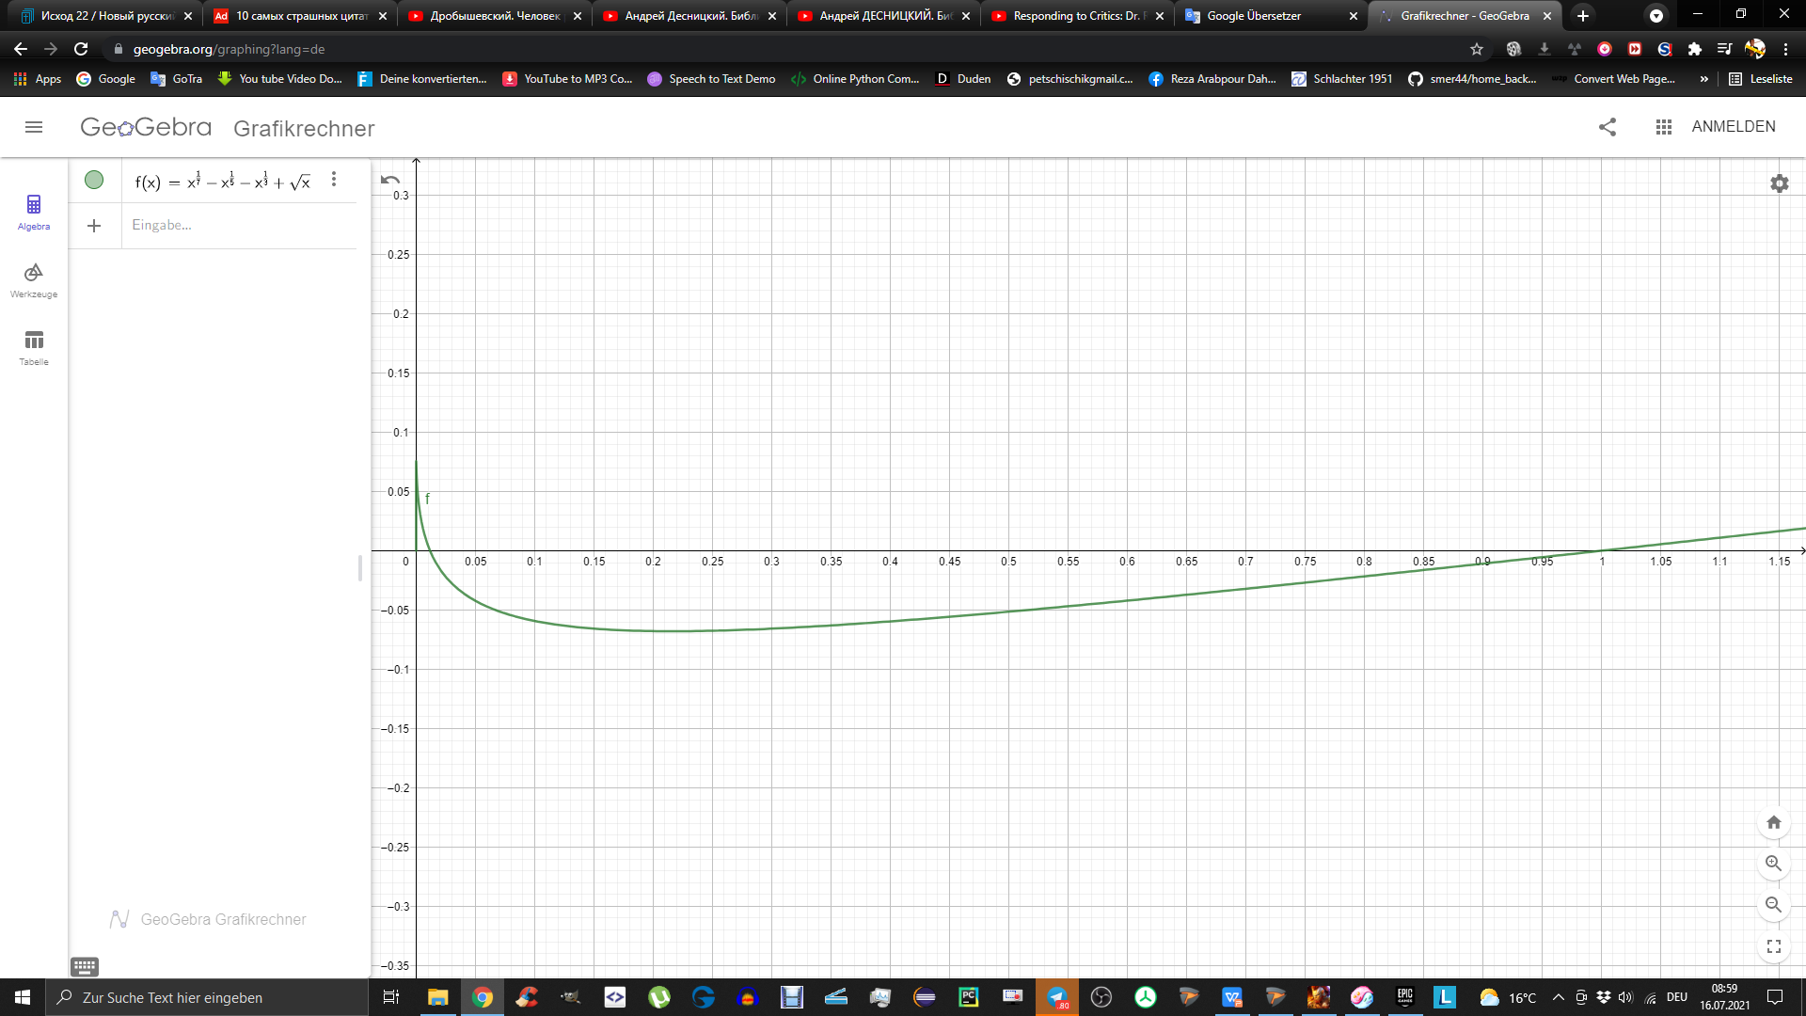
geometrical raw usage

Slide 19
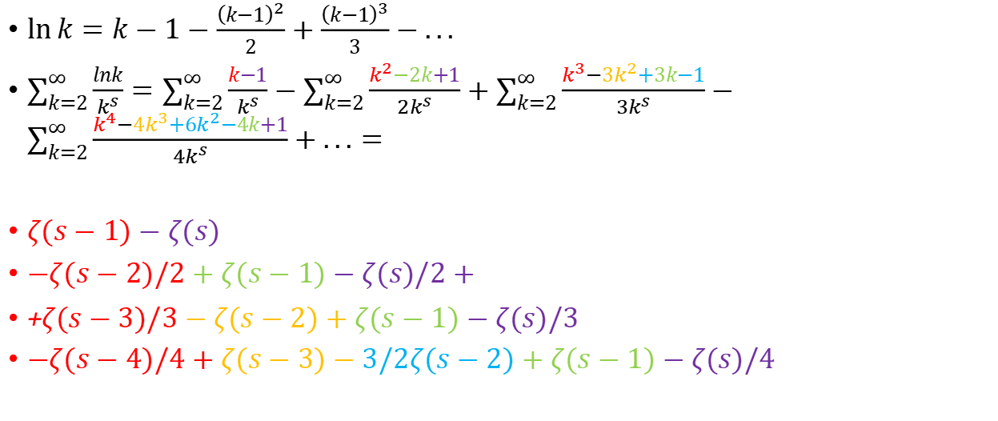
$\ln{k=k−1−\frac{{\left(k−1\right)}^{2}}{2}}+\frac{{\left(k−1\right)}^{3}}{3}−...$
$\sum_{k=2}^{∞}{\frac{lnk}{k^{s}}}=\sum_{k=2}^{∞}{\frac{k−1}{k^{s}}−\sum_{k=2}^{∞}{\frac{k^{2}−2k+1}{{2k}^{s}}}}+\sum_{k=2}^{∞}{\frac{k^{3}−3k^{2}+3k−1}{{3k}^{s}}}−\sum_{k=2}^{∞}{\frac{k^{4}−4k^{3}+6k^{2}−4k+1}{{4k}^{s}}}+...=$
$ζ(s−1)−ζ(s)$
$−ζ(s−2)/2+ζ(s−1)−ζ(s)/2+$
+$ζ(s−3)/3−ζ(s−2)+ζ(s−1)−ζ(s)/3$
$−ζ(s−4)/4+ζ(s−3)−3/2ζ(s−2)+ζ(s−1)−ζ(s)/4$

Slide 20
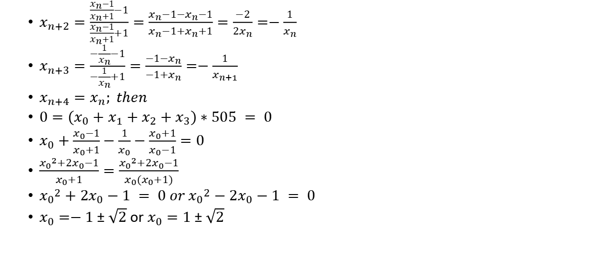
$\sum_{n=0}^{2020}{x_{n}}=0;x_{n+1}=\frac{x_{n}−1}{x_{n}+1}$; find $x_{0}$
$x_{n+2}=\frac{\frac{x_{n}−1}{x_{n}+1}−1}{\frac{x_{n}−1}{x_{n}+1}+1}=\frac{x_{n}−1−x_{n}−1}{x_{n}−1+x_{n}+1}=\frac{−2}{2x_{n}}=−\frac{1}{x_{n}}$
$x_{n+3}=\frac{−\frac{1}{x_{n}}−1}{−\frac{1}{x_{n}}+1}=\frac{−1−x_{n}}{−1+x_{n}}=−\frac{1}{x_{n+1}}$
$x_{n+4}=x_{n}; then$
$0=(x_{0}+x_{1}+x_{2}+x_{3})∗505 = 0$
$x_{0}+\frac{x_{0}−1}{x_{0}+1}−\frac{1}{x_{0}}−\frac{x_{0}+1}{x_{0}−1}=0$
$\frac{{x_{0}}^{2}+2x_{0}−1}{x_{0}+1}=\frac{{x_{0}}^{2}+2x_{0}−1}{x_{0}(x_{0}+1)}$
${x_{0}}^{2}+2x_{0}−1 = 0 or {x_{0}}^{2}−2x_{0}−1 = 0$
$x_{0}=−1±\sqrt{2}$ or $x_{0}=1±\sqrt{2}$

Slide 21


$$\sum_{n=1}^{∞}{\frac{1}{1+\sqrt{2}+\sqrt[3]{3}+...+\sqrt[n]{n}}}$$
for big n we have $\sqrt[n]{n}−>1 with max in n = e, max ≈1.442$
so all summands at the bottom are less then 2
$\sum_{n=1}^{∞}{\frac{1}{1+\sqrt{2}+\sqrt[3]{3}+...+\sqrt[n]{n}}}>\sum_{n=1}^{∞}{\frac{1}{2+2+...2 (n times)}}=\sum_{n=1}^{∞}{\frac{1}{2n}}=\frac{1}{2}(Harmonic)$
given sequence is bigger then harmonic, therefore it diverges.

